Slide 1

How F# Learned to Stop Worrying and Love the Data
Tomas Petricek @tomaspetricek
Conspirator behind http://fsharp.org

Slide 2
software stacks trainings teaching F# user groups snippets mac and linux cross-platform books and tutorials
F# Software Foundation
F# community open-source MonoDevelop
http://www.fsharp.org
contributions research support consultancy mailing list

Slide 3

The Data

Slide 4
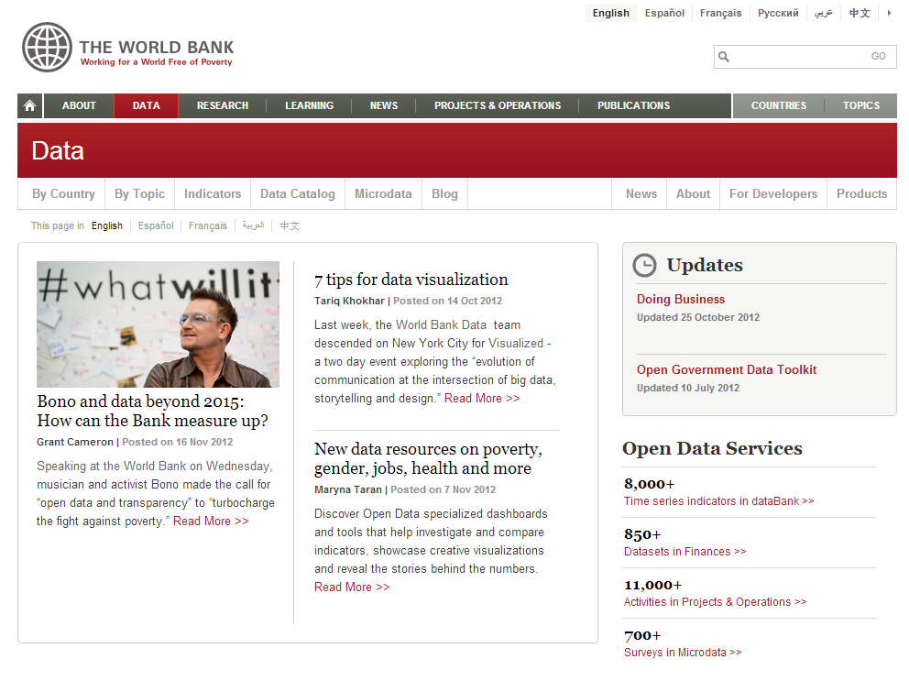
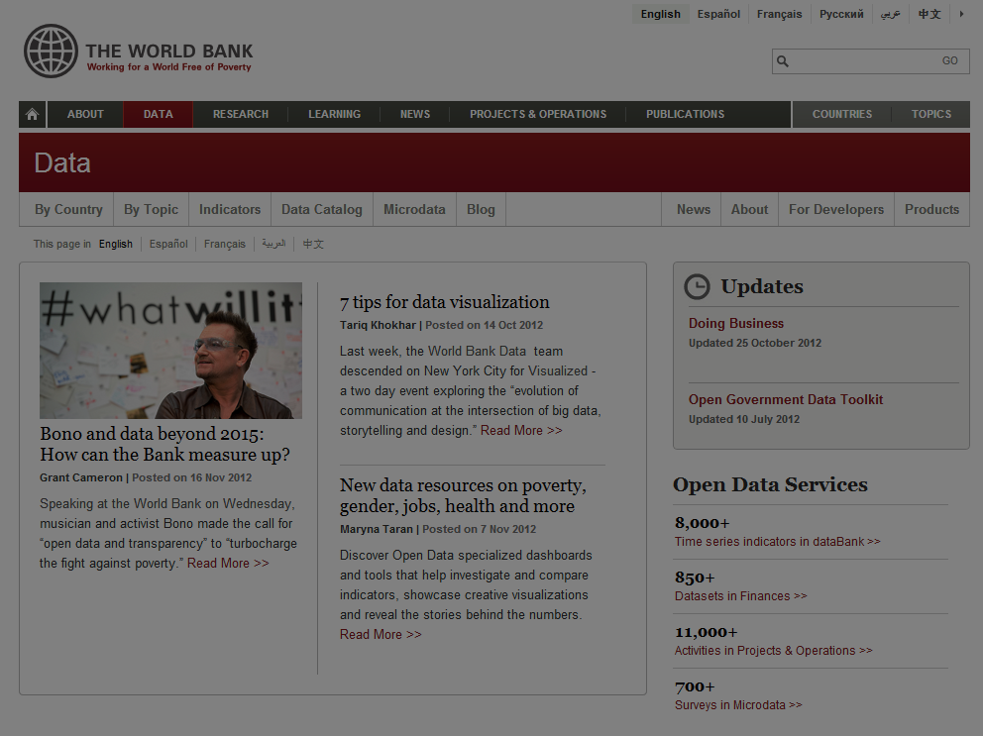

Slide 5
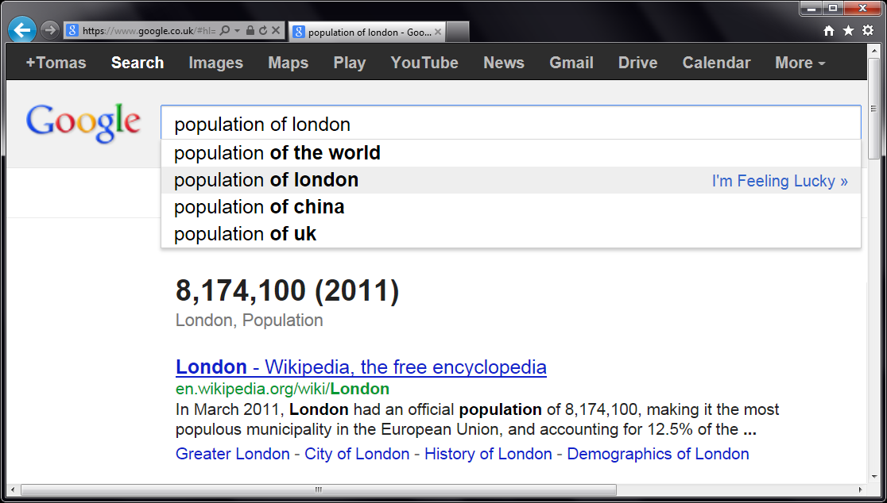
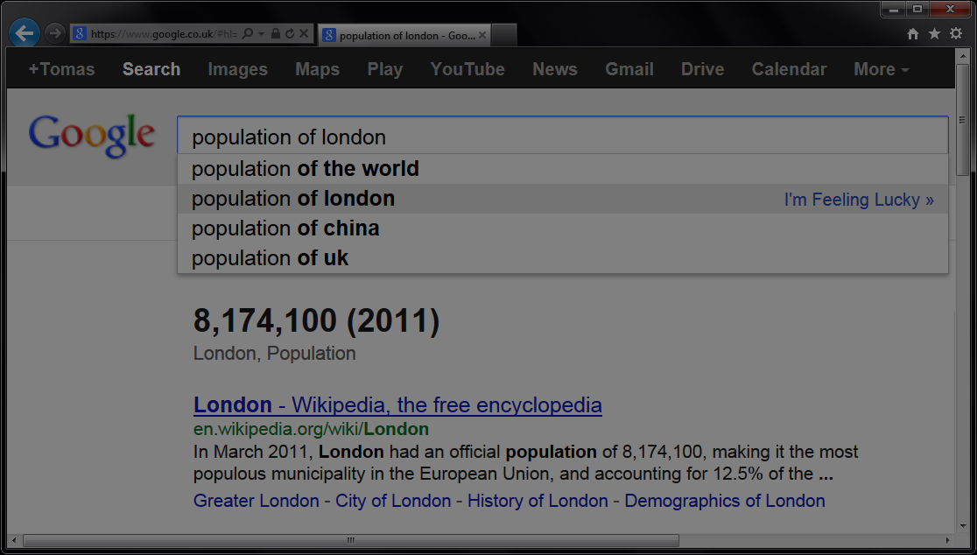


Slide 6
let wb = WorldBank()
w
b
.

Slide 7
[DEMO]
Exploring WorldBank Data

Slide 8
Asynchronous programming
Asynchrony matters
Node.js and C# 5.0
F# Async workflows
Without inversion of control
Exception handling and loops simple
Sequential and parallel composition

Slide 9
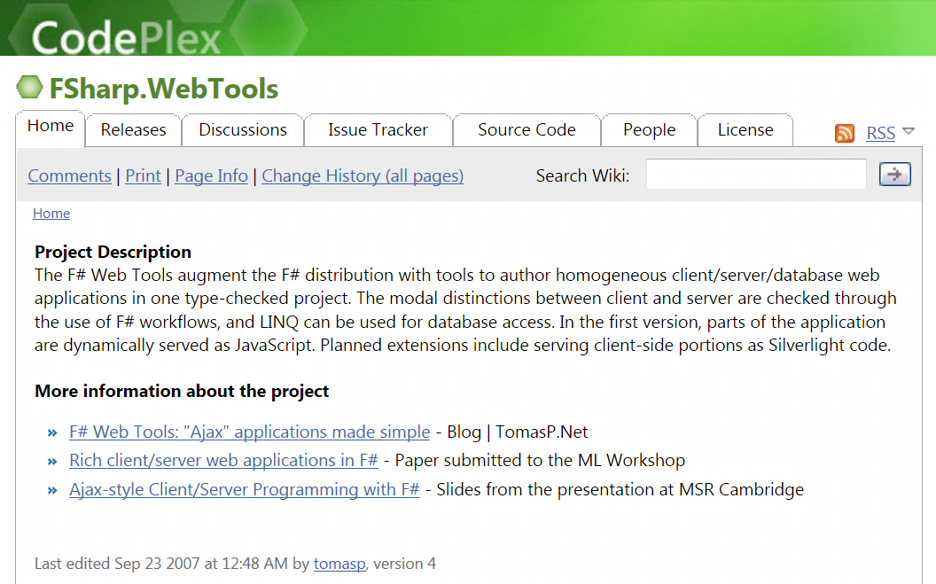
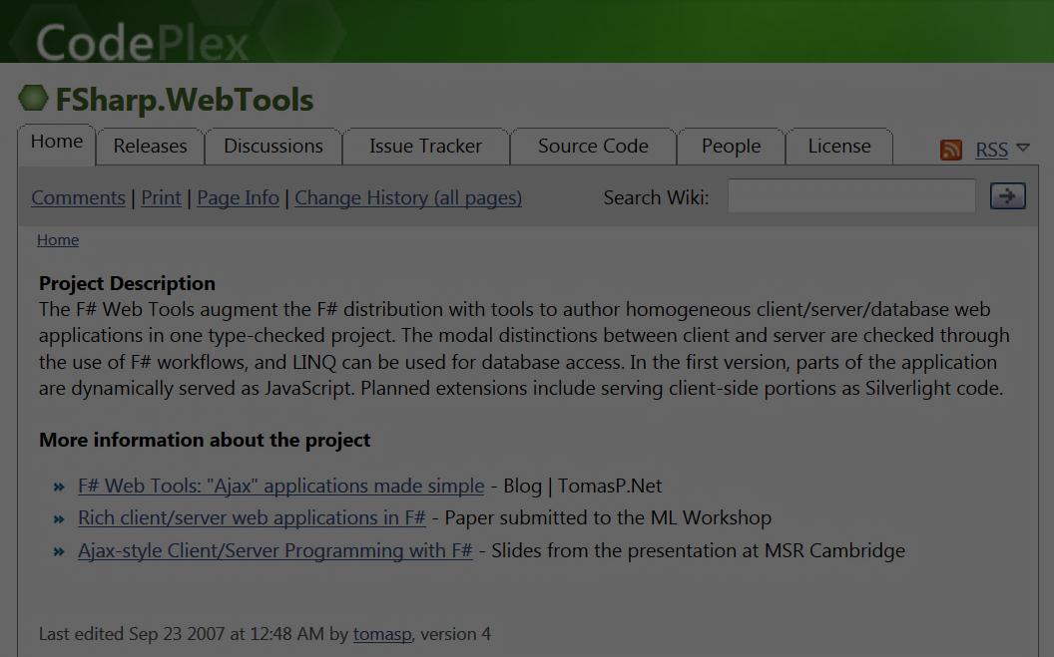

F# to JavaScript
Before it was cool.

Slide 10
[DEMO]
WorldBank App for the Web

Slide 11
F# to JavaScript
TypeScript type provider
Import types for JS libraries
Somebody else writes them!
Libraries & frameworks
Open source: FunScript and Pit
Commercial: IntelliFactory WebSharper

Slide 12
Accessing REST services
REST (Representational State Transfer) is a style of software architecture for distributed systems such as the World Wide Web. REST has emerged as a predominant Web service design model.

Slide 13
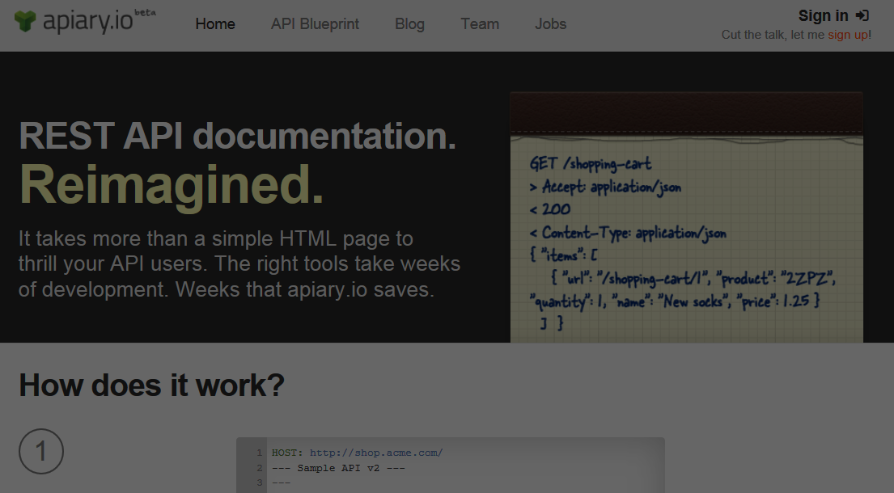
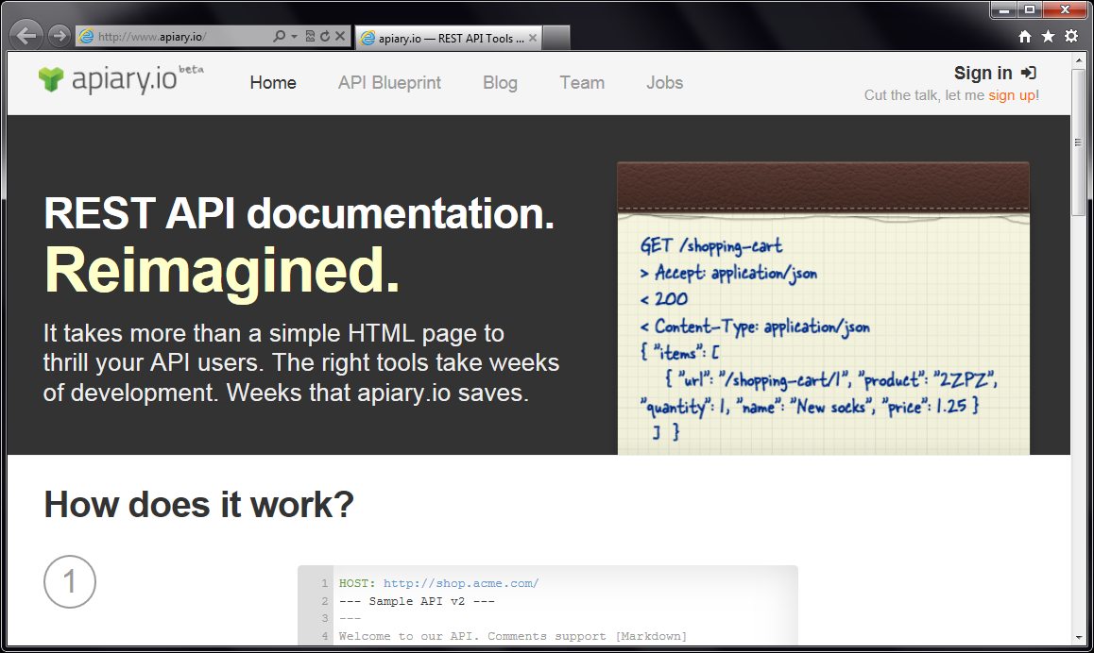
Accessing REST services

Slide 14
[DEMO]
Introducing Apiary Type Provider

Slide 15
Apiary.io Type Provider
Common REST conventions
GET /movie/{id} Get movie summary
GET /movie/{id}/casts Get cast details
Types from JSON samples
{ "page": 1, "total_pages": 1, "total_results": 5,
"results": [ { "title": "Skyfall", "id": 94221 } ] }

Slide 16
[DEMO]
The Movie Database App for the Web

Slide 17
Type Providers in Action
WorldBank Type Provider
JSON Type Provider
Apiary Type Provider
TypeScript Type Provider

Slide 18
[SUMMARY]
Where to learn more?

Slide 19
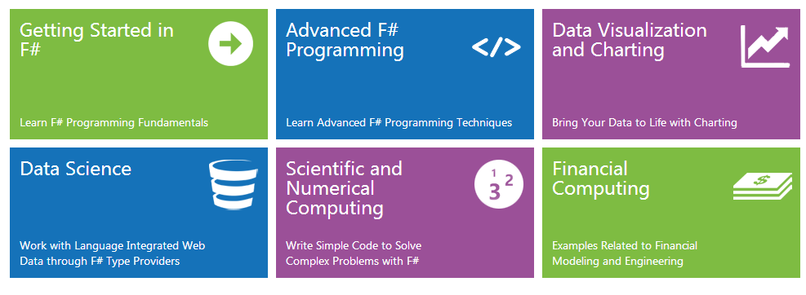
Online resources
www.fsharp.org Information & community www.tryfsharp.org Interactive F# tutorials

Slide 20
User groups and trainings
Functional and F# trainings
In London and New York
Get in touch tomas@tomasp.net
F#unctional Londoners meetup
http://meetup.com/FSharpLondon/

Slide 21
F#, Data and Services
other languages web type script REST
R language transparent java script
tool support extensibility code-first unstructured data static typing inference schema
Love the Data
and integration

